Slide 1
Students Result Management System

Slide 2
Outline
  Project Overview & Objectives
  Data Engineering & Methodology
  Technical Implementation(EDA & Preprocessing)
  Variables & Model Evaluation
  Practical Application & Conclusion

Slide 3
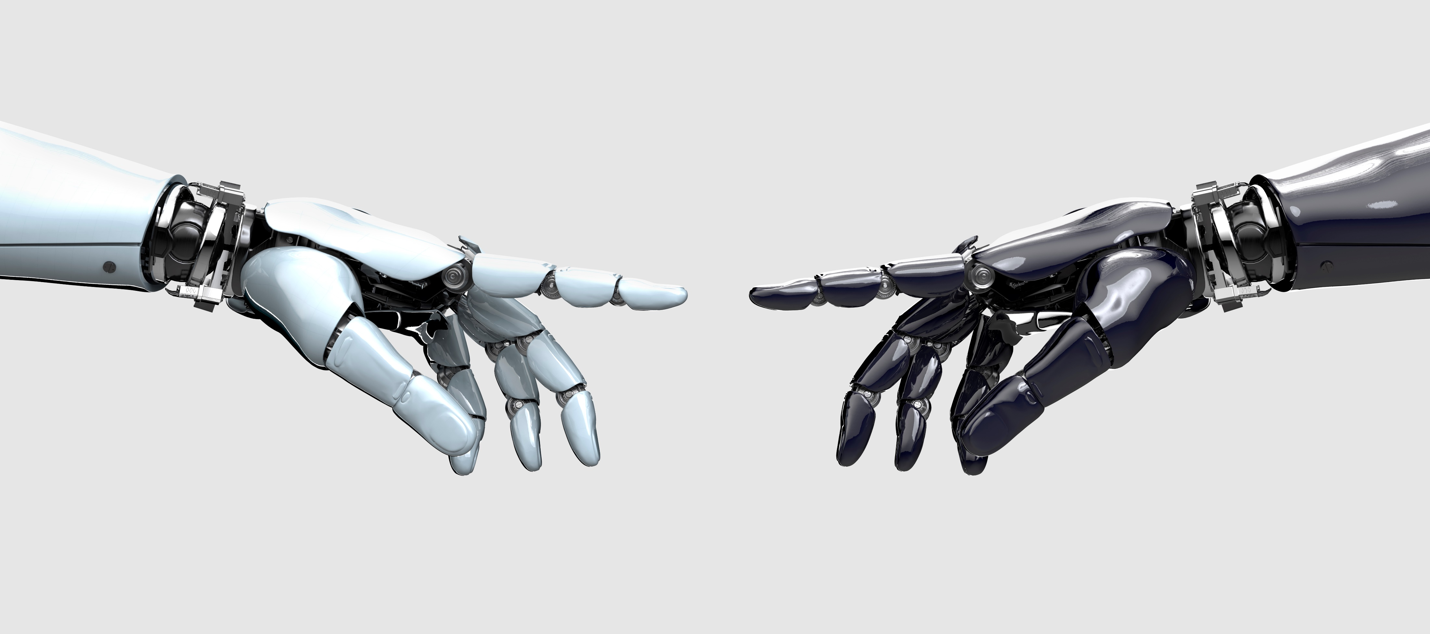
Project Overview & Objectives
Project Title : Students Result Management System.
Data Source: Student Performance Dataset from Kaggle
Primary Aim: To build a predictive model that identifies students at academic risk and also identify possible influencing factors.
The Goal: Develop a system to classify students as either 'At Risk' (intervention needed) or 'Not At Risk' (progressing normally).

Slide 4
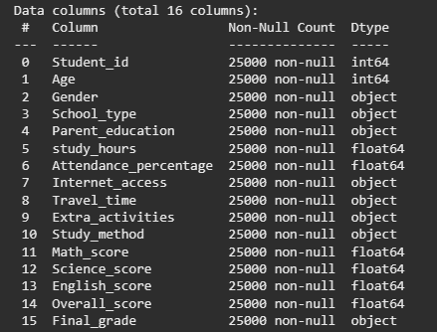
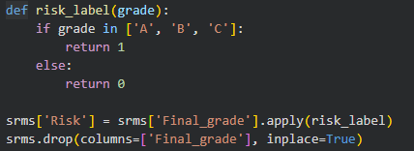
Data Engineering & Methodology
Our dataset contains a total of 16 columns.
A target variable “risk” was created which is derived from “final grade”
“Not at risk” : For “final grade” A,B and C
“At risk”: For “final grade” D, E and F
The multi-category grade prediction was shifted to Binary Classification to make the system more direct and actionable for intervention.

Slide 5
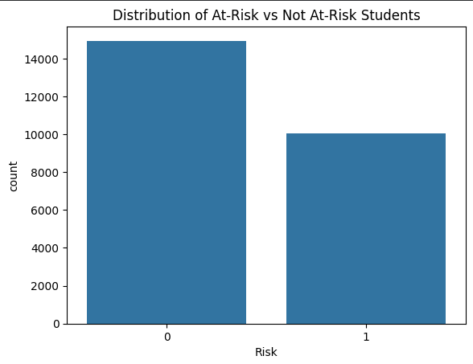
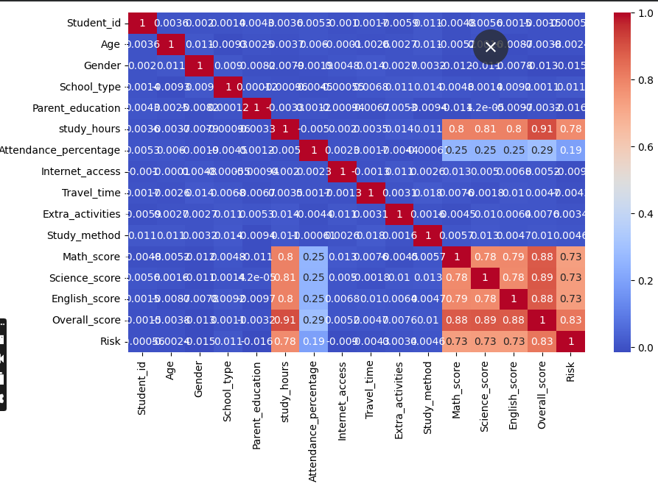
Technical Implementation(EDA & Preprocessing)
Before building a model, you have to understand the shape of the data. A distribution check was carried out to analyze how many students were "At Risk" versus "Not At Risk." If the groups are uneven (e.g., 90% are passing), the model might struggle to learn what "At Risk" looks like.
A correlation analysis was carried out also to know if there were existing relationships between variables. For example, does lower attendance correlate with higher risk
Heatmap showing correlation

Slide 6
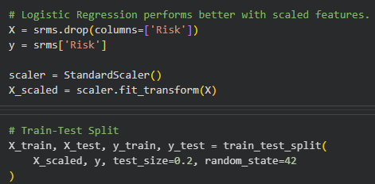
Technical Implementation(EDA & Preprocessing)
As part of the pre-processing, label encoding is done. The computer does not understand the variable so we encode them into numbers. This is just the process of converting categories into numbers.
Some numbers in your data might be small (Age: 15–20), while others are large (Study Hours: 0–100). If you don't scale them, the model might think Study Hours are "more important" just because the numbers are bigger. StandardScaler brings all variables to the same scale so the model treats them fairly.

Slide 7
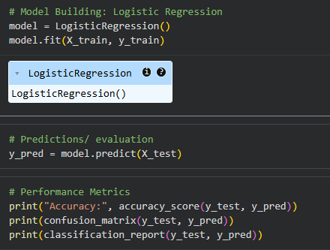
Variables & Model Evaluation
The model being used is logistic regression. It is a classification algorithm. It is excellent for binary outcomes. Also, It doesn't just give a category; it gives a probability score (e.g., "This student has an 85% chance of being At Risk").
Model evaluation focused on identifying the most influential predictors, which included factors like attendance percentage, study hours, and previous scores in core subjects like Math and Science. The performance of the system was measured using high-level metrics such as precision, recall, and the F1-score to ensure balanced results. With an overall accuracy of 92%, the model proved highly reliable.
The evaluation used a Confusion Matrix to visualize the accuracy of "At Risk" detections, confirming that the system has a high success rate in identifying struggling students while maintaining a low rate of false alarms.

Slide 8
Practical Application & Conclusion
In conclusion, this Students Result Management System offers a practical solution for modern educational challenges. By processing unseen student data, the model can provide administrators with a probability of risk, allowing them to prioritize resources for high-need individuals before the end of the academic term. The system demonstrates that data-driven insights can lead to more proactive educational environments.
Future applications could involve integrating real-time attendance tracking to provide even more immediate feedback, further bridging the gap between data science and student success.

Slide 9
THANKS FOR LISTENING
END OF PRESENTATION
GROUP 1

